Slide 1
CSE 727: Seminar
Selected Topics on Internet
of Things
Presenter: Sai Suresh Dalli
UBIT No. 50316378

Slide 2
SenseHAR:
A Robust Virtual Activity Sensor for Smartphones and Wearables
Jeya Vikranth Jeyakumar, Liangzhen Lai, Naveen Suda, and Mani Srivastava. 2019. In The 17th ACM Conference on Embedded Networked Sensor Systems (SenSys ’19), November 10–13, 2019, New York, NY, USA. ACM, New York, NY, USA, 14 pages. https://doi.org/10.1145/3356250.3360032

Slide 3
Smartphones and Wearables
Owned by more than 80% of the U.S. population
Equipped with a rich pool of sensors
Inertial Measurement Unit(IMU):
Accelerometer (A)
Gyroscope (G)
Magnetometer (M)

Slide 4
Human Activity Recognition(HAR)
Challenging time series classification task
Predicts the movement of a person based on sensor data
Traditional methods involve deep domain expertise and
feature extraction
Recent methods use deep learning which automatically
learns features from the raw sensor data

Slide 5
Existing Methods for HAR
Impractical to train a new model from scratch for all devices and device
combinations for every application

Slide 6
Challenge 1- Heterogeneity in devices
Smartphones
AGM Sensors
> 50 Hz
Smartwatches
A or AG Sensors
< 50 Hz
1. Different sensors in each Device
2.Different sampling rates
Earables
AG Sensors
10-100 Hz

Slide 7
Challenge 2- Different Locations
Possible Locations :
Pockets
Wrists
Ankles
Arms
Ears
Waist

Slide 8
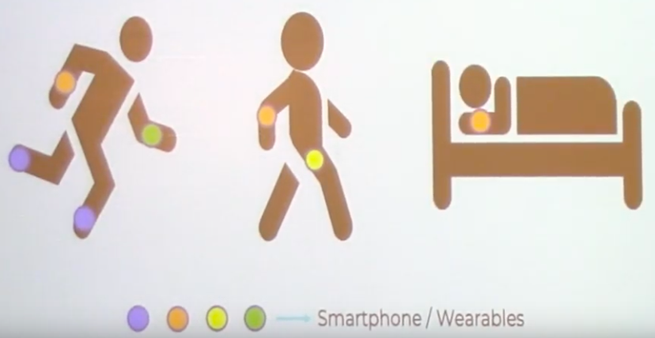
Challenge 3- Devices carried by a person vary over time

Slide 9
Our Solution
Create a robust ‘Virtual Activity Sensor’ by sensor fusion of the IMU sensors using Deep Learning
Have the same format and similar behavior regardless of sensor’s availability, locations, sampling rates etc.
Decouple Hardware and Software
Help ML engineers to develop their algorithms in a hardware-agnostic way based on this virtual activity sensor

Slide 10
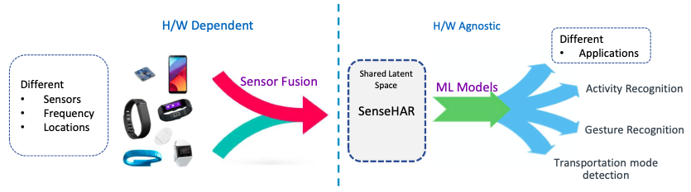
Our Solution- Overview

Slide 11
A Ideal Virtual Activity Sensor
A Ideal Activity sensor should:
Have a constant frequency (say 25 Hz)
Have only a few dimensions (like axes in sensors)
Capture correlation across the sensors and locations
Be generalizable
Small size model (Few parameters)

Slide 12
How Do We Obtain This Virtual Activity Sensor ?

Slide 13
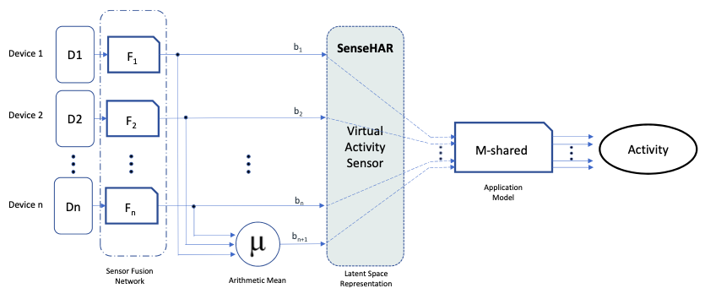
Branched Parallel Training Framework

Slide 14
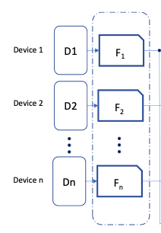
Sensor Fusion Model
Stage 1
Stage 2
Stage 3
Sensor Fusion
Model
Sensor Fusion
Network

Slide 15
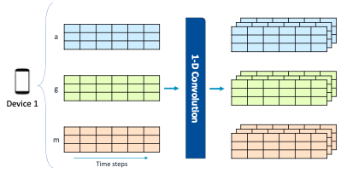
Stage 1: Extracts Intra-Sensor Features

Slide 16
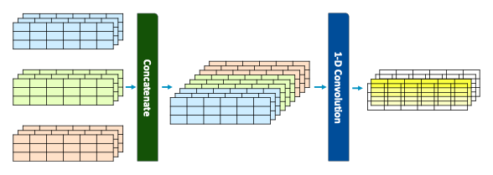
Stage 2: Capture Inter-Sensor Features

Slide 17
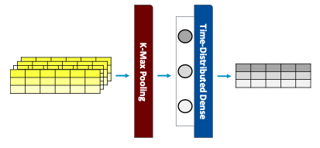
Stage 3: Obtain a Constant Frequency

Slide 18
IMPLEMENTATION

Slide 19
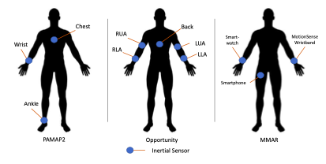
Constructing SenseHAR

Slide 20
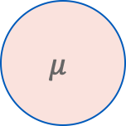
Testing on subset of devices
Just one Device:
D_{n}
Pretrained Application Model
Activity
F_{n}
Two or more devices:
D_{n}
F_{n}
$$μ$$
Pretrained Application Model
Activity
D_{n}
F_{n}
Mean

Slide 21
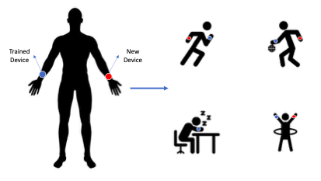
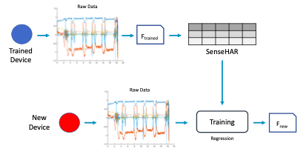
Calibrating for a new hardware
1. Synchronous Data Collection
2. Calibration
3. Combine with existing Application model
Pretrained
Application model
Activity
F_{new}

Slide 22
RESULTS

Slide 23
Dataset Details
Dataset | Activities | Sensors | Frequency | Locations
PAMAP2 | 12 | AGM | 100 Hz | Wrist, Ankle, Chest
Opportunity | Major: 4 Gestures: 17 | AGM | 30 Hz | Back, LLA, LUA, RLA, RUA
MMAR | 5 | Smartphone (AGM) Smartwatch (AG) Wristband (AG) | 100 Hz 50 Hz 25 Hz | Pocket Right Wrist Left Wrist

Slide 24
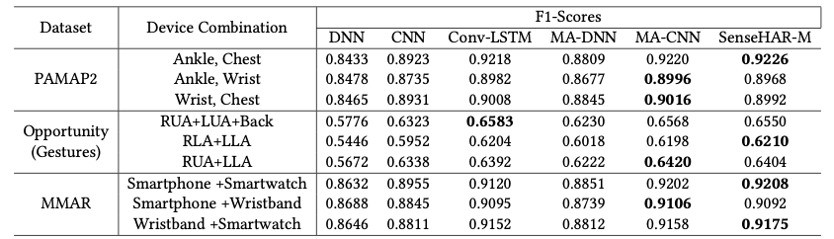
Different combination of devices
Baseline models are trained from scratch on the labelled data for these different combination of devices
SenseHAR-M doesn’t require retraining for the new combination of devices
SenseHAR-M achieves state-of-art performance

Slide 25
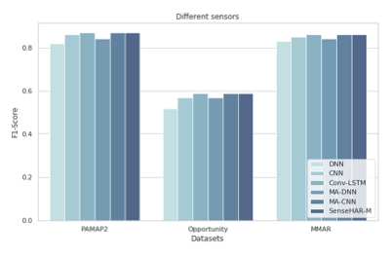
New device with Different Sensors

Slide 26
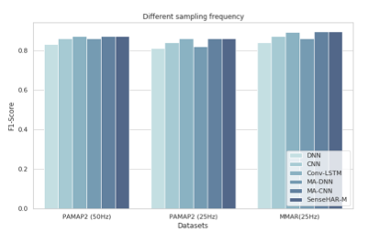
New device with Different Sampling Frequency
1. Wrist device that
Collects data at 50 Hz
2. Ankle device
that collects data
at 25 Hz
3. Smartwatch on the
left wrist at 25 Hz

Slide 27
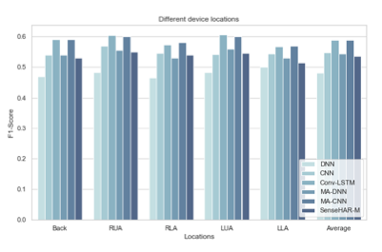
New device in a Different Location
There‘s a 5 drop in performance on average for a new device in a different location

Slide 28
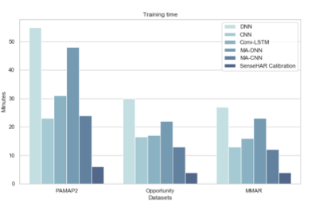
Training time for a New Device

Slide 29
Future Work
Evaluate for fine-grained activities
Support for devices less than 25 Hz
Zero padding the input sequence
Support arbitrary sampling rates(deconvolutional layers)
Explore techniques at the sensor fusion step
Adaptive weighted averaging
Normalization

Slide 30
Conclusion
Constructed a virtual activity sensor (SenseHAR) that is robust to the variations and availability of the
inertial sensors using deep learning
Explained the method to calibrate the SenseHAR for a new device in the absence of labeled data
with the help of an existing calibrated devices
Did a comprehensive evaluation of SenseHAR and compared its performance with the state-of-the-art
Multimodal architectures

Slide 31
Questions?

Slide 32
References
Jeya Vikranth Jeyakumar, Liangzhen Lai, Naveen Suda, and Mani Srivastava. 2019. SenseHAR: A Robust Virtual Activity Sensor for Smartphones and Wearables. In The 17th ACM Conference on Embedded Networked Sensor Systems (SenSys ’19), November 10–13, 2019, New York, NY, USA. ACM, New York, NY, USA, 14 pages. https://doi.org/10.1145/3356250.3360032
SaymaAkther,NazirSaleheen,ShahinAlanSamiei,VivekShetty,EmreErtin,and Santosh Kumar. 2019. mORAL: An mHealth Model for Inferring Oral Hygiene Behaviors in-the-wild Using Wrist-worn Inertial Sensors. Proceedings of the ACM on Interactive, Mobile, Wearable and Ubiquitous Technologies 3, 1 (2019), 1.
https://www.youtube.com/watch?v=WVYk9FxToXI

